Slide 1

Flight Mechanics
Alexander Dada

Slide 2
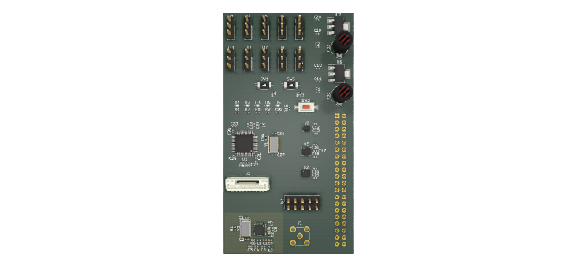
Contents
What ?! Why ?!
Mathematical Modelling
Simulation
Simulation Tools
Outputs

Slide 3
Top Level Requirements
Project Spearhead will be A 1:5 scale UAV designed to simulate human transport missions. It will be monitored from a ground station. For a successful outcome, the aircraft will need to:
Functional
Non-Functional
Take-off and land vertically
Transition from vertical to horizontal flight and back
Fly autonomously between “Vertipads”
Recover and land safely in the case of a set of known failure modes
Perform basic flight manoeuvrers and operations
Record flights from onboard cameras
Handle repeated flights over a year, up to 1000 flight hours
Designed to Meet Aerospace Fidelity Standards
Designed for Decentralised Manufacture
Designed to be Directly Transferable to Final VTOL

Slide 4
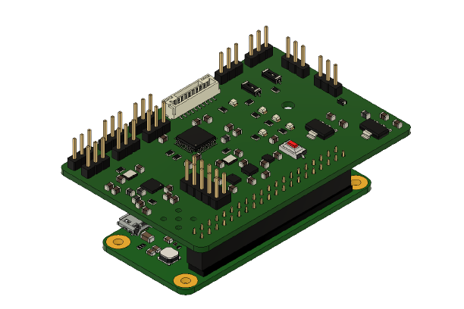
System ELEMENTS
Computation
Microcontrollers and Microprocessors
Single Board Computers (SBCs)
Power Train
Motors
Electronic Speed Controllers (ESCs)
Batteries and Battery Management Systems (BMSs)
Communications and Peripherals
External High and/or Low Band Radio Frequencies
Internal I2C, UART, SPI
Sensors
Inertial Mesurment Units (IMUs)
Magnetic Angular Rate Gravity Sensors (MARGs)
Barometric Pressure Sensors (BPSs)
Global Positioning Systems (GPSs)
Firmware
Feedback Control
State Estimation
Hardware Abstraction
Hardware Interface Libraries

Slide 5

System Architectures
Full Tech Architecture Development
Pre-Developed Architectures
e.g
Pros
Predefined standards
Pre-made hardware, firmware and software implementation options
Cons
Obtuse Libraries
Limited Hardware Support
Pros
Full System Control
Cons
Loads of Works Upfront

Slide 6



Design tools
Pros
Open Source
Cons
Version and file structure control
Pros
Integration with CAD
Collaboration
Cons
Clunky
Pros
Advanced Tools
Collaboration
Cons
Expensive

